Slide 1
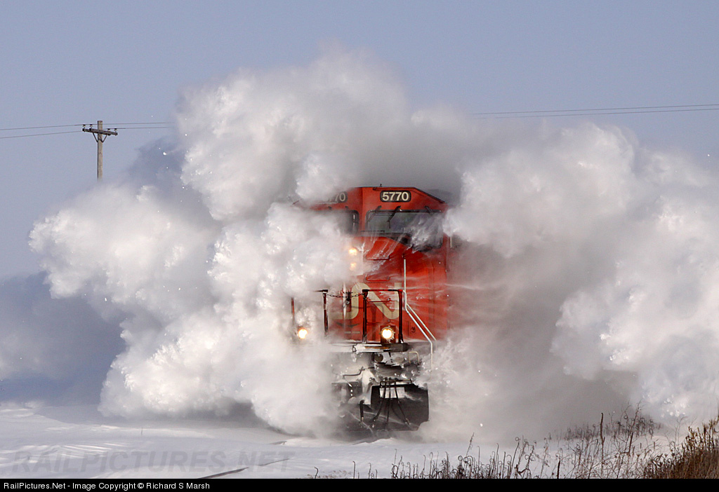







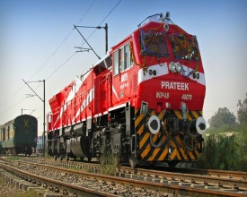

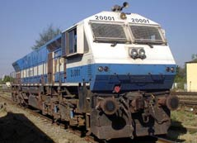
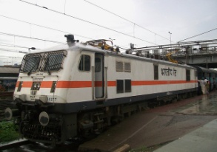


ELECTRONIC PRODUCT DESIGN , DEVELOPMENT & SERVICES ENTERPRISE
COMPANY PROFILE- RAIL SYSTEMS
N & S SOLUTIONS PVT LTD .,
REGISTERED OFFICE & DEVELOPMENT CENTRE
NO 37-38, RELIABLERESIDENCY,
1ST MAIN , 8TH CROSS, HSR LAYOUT,
HARLUR, BANGALORE – 560102
No: 01100117768

Slide 2
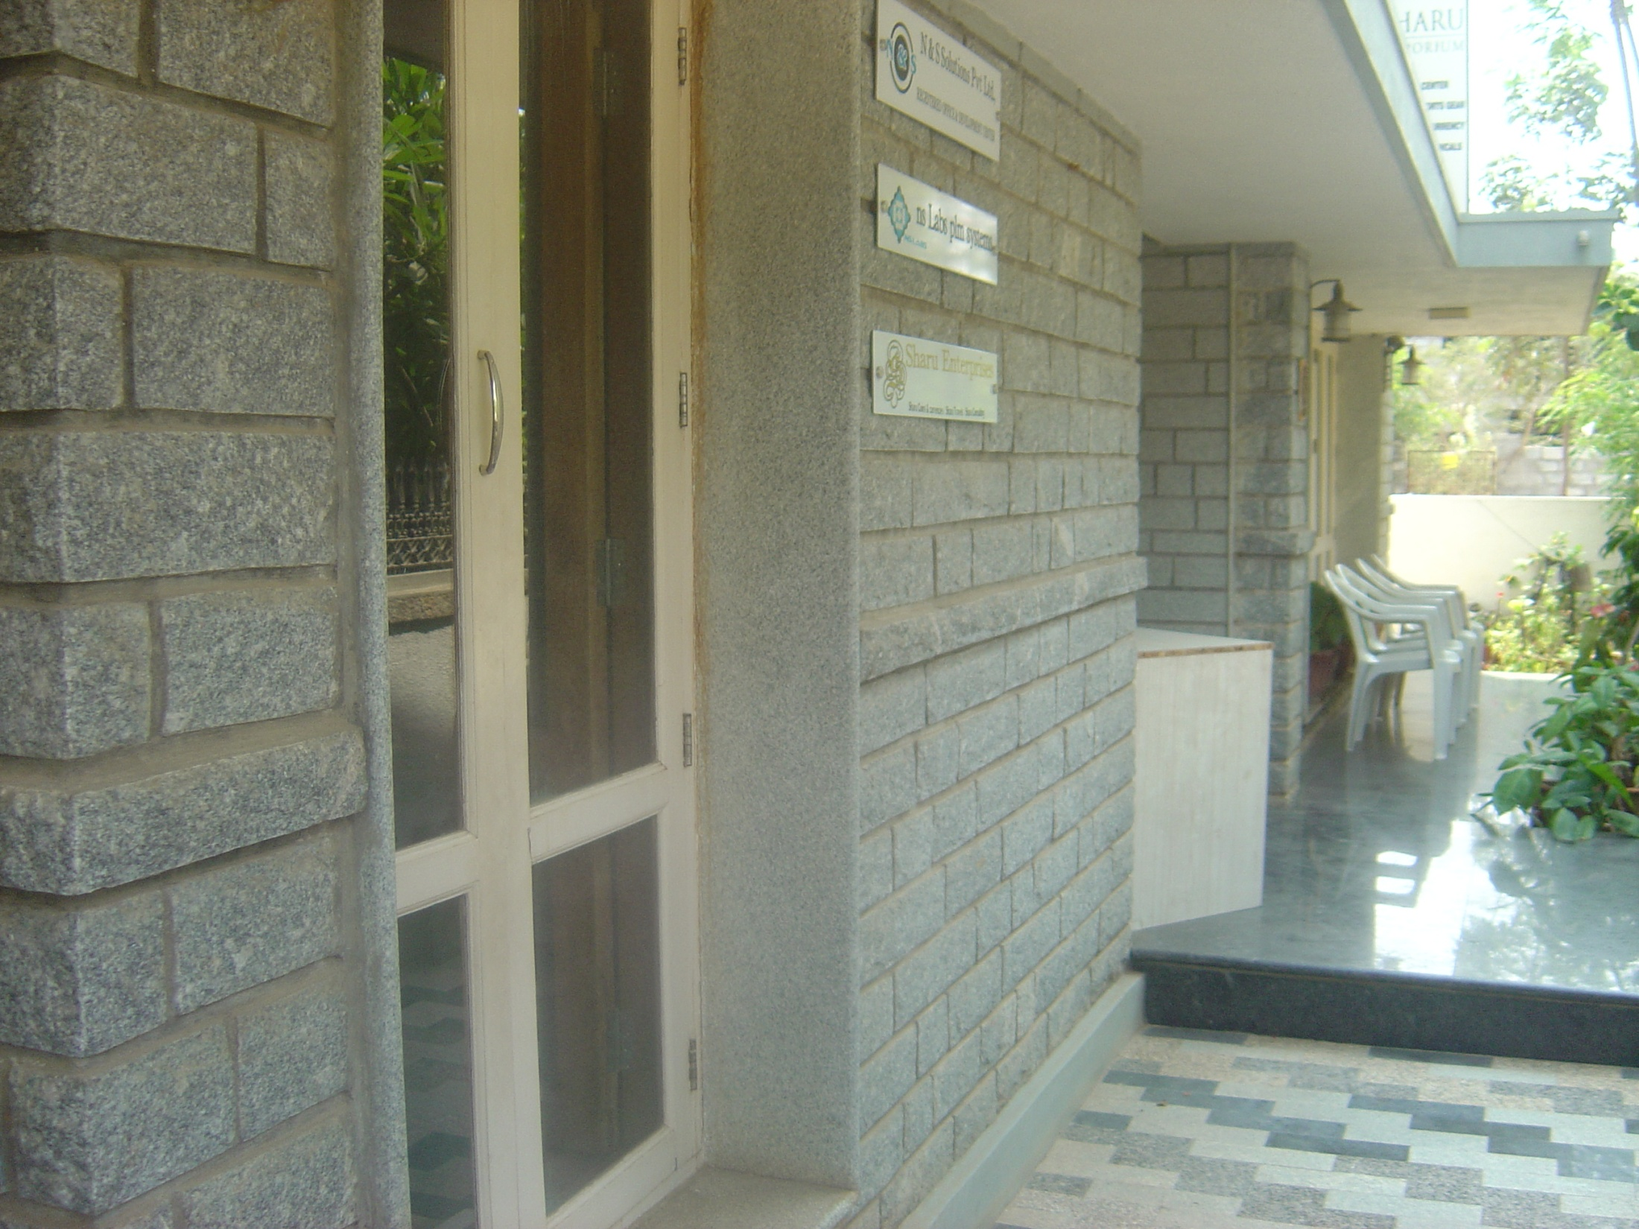
Application Engineering
Product Design
Product Life Cycle Management
Engineering
Manufacturing
Assembly & Testing
Environment Qualification Test
Commissioning
After – Sales & Services

Slide 3
History
N& S Solutions Pvt Ltd was established has a Trading company in 1999 and formally converted to a Design Manufacturing Enterprise in August 2009.
The Promoters of the Company are, Shri. K.S Shailesh Kumar and Shri. Arun Verma , They Both come with more than two decades of experience and domain knowledge specifically in Locomotive Engineering , Project Management, Manufacturing , Engineering and Knowledge Management Industries.
N & S Solutions Pvt Ltd has a history of successfully replacing OEM Manufactured critical Products at lower cost and Technological improvements to customers using new Technologies locally.

Slide 4

SMOKE / FIRE DETECTION SYSTEMS
1- Hybrid Smoke / Fire Detection with Alarm System– NS1060.01
2- Aspiration Based Smoke / Fire Detection with Alarm System–
NS1060.02
3- Point Detector type Smoke / Fire Detection with Alarm System -
NS1060.03

Slide 5

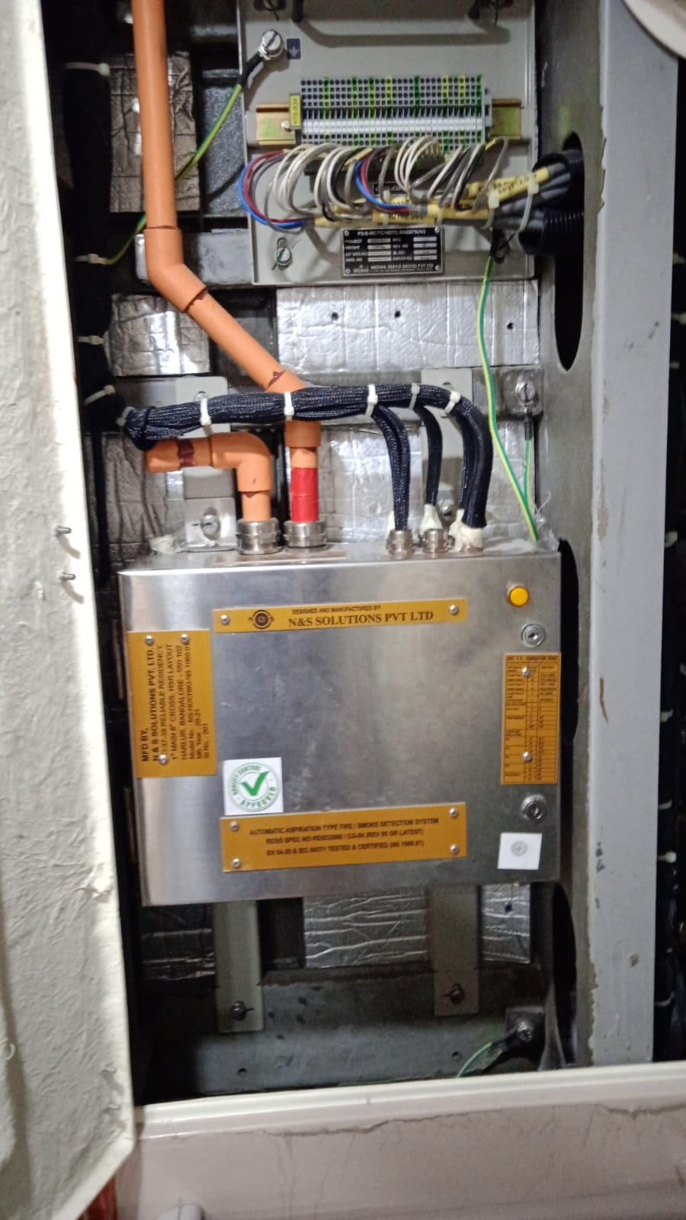
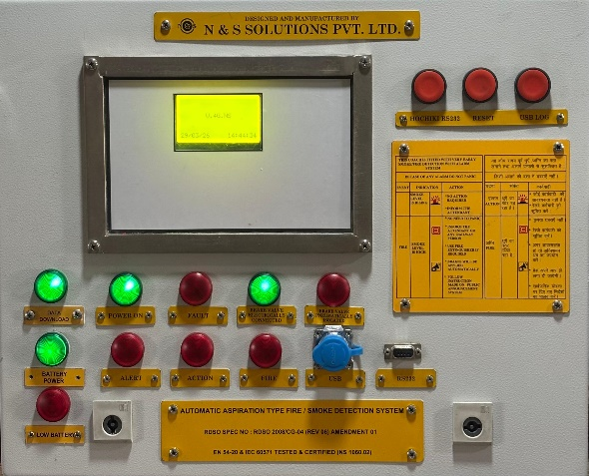
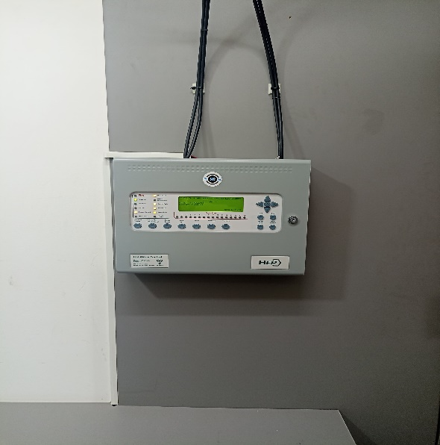
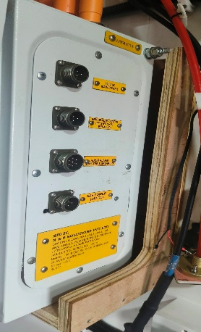
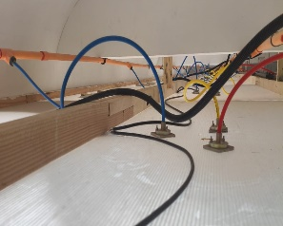
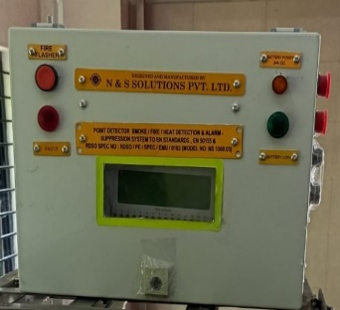
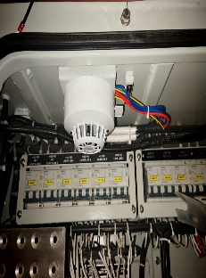
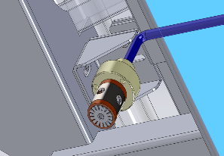
NS FIRE DETECTION SYSTEM
NS1060.01 HYBRID FDS
NS1060.02 ASD FDS
NS1060.03 PD FDS

Slide 6
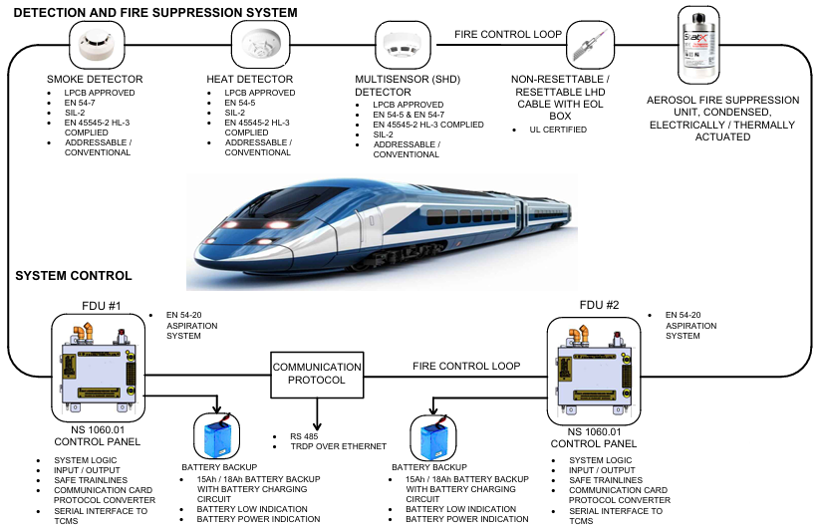
HYBRID FIRE DETECTION SYSTEM– NS1060.01
SYSTEM ARCHITECTURE

Slide 7
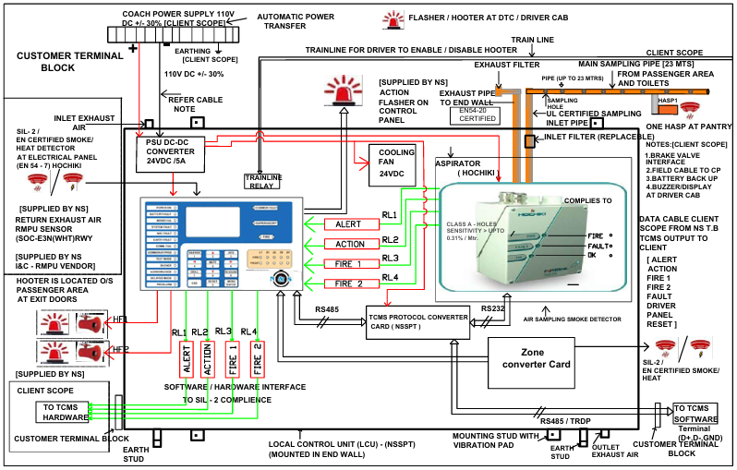
HYBRID FIRE DETECTION SYSTEM– NS1060.01
BLOCK DIAGRAM

Slide 8
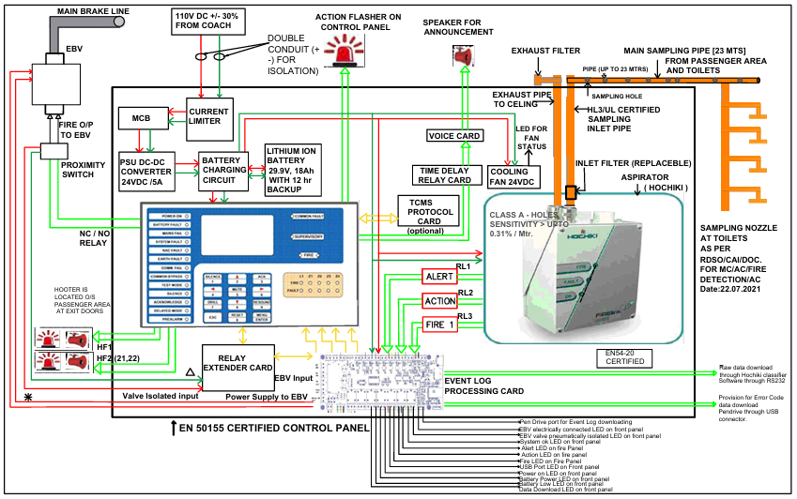
ASPIRATION BASED FIRE DETECTION SYSTEM– NS1060.02
BLOCK DIAGRAM

Slide 9
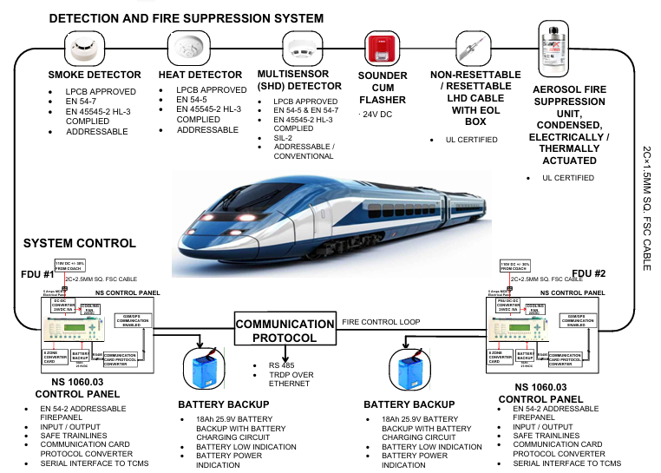
POINT DETECTOR TYPE FIRE DETECTION SYSTEM– NS1060.03
SYSTEM ARCHITECTURE

Slide 10
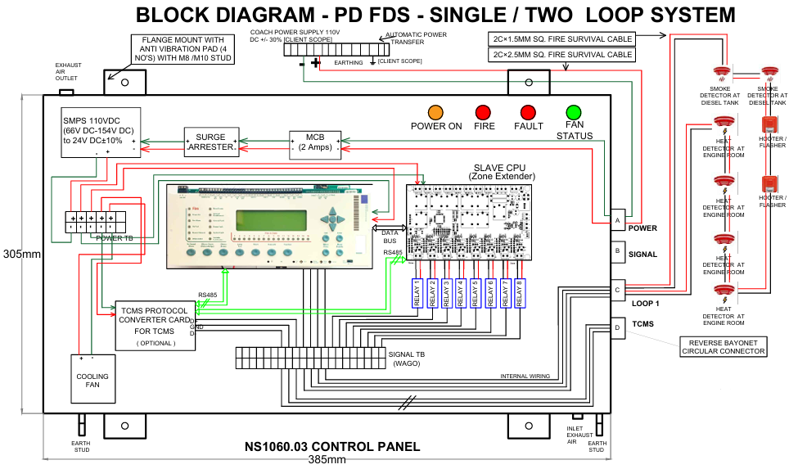
POINT DETECTOR TYPE FIRE DETECTION SYSTEM– NS1060.03
BLOCK DIAGRAM

Slide 11

ELECTRIC LOCOMOTIVE – SWITCHING SYSTEMS
1- MAXIMUM CURRENT RELAY – NS 1180
2- MINIMUM VOLTAGE RELAY – NS 1110.02

Slide 12
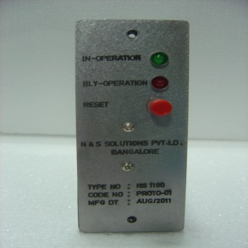
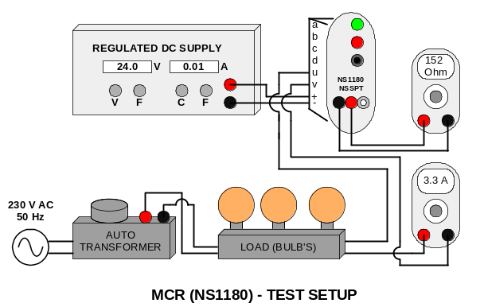
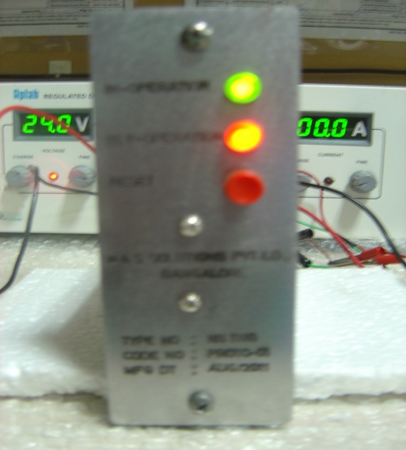
MAXIMUM CURRENT RELAY – NS1180
NSSPT Developed Maximum Current Relay is used to protect the Control systems at other end from overload. Maximum Current Relay are used in WAG-9, 3 – Ø, 50 Hz, 6000 Hp locomotives of Indian Railways.
The NSR family of Maximum Current Relay are low power module for electrical and electronics system safety. This module provides high accuracy, efficiency, and reliability that remain constant over the entire operating range and their full life.
TEST SETUP
FEATURES
Output error is limited to 1.5% at T=25°C.
Fast response.
Low losses.
High accuracy.
100mv/amp sensitivity.
Linear operation.
Nearly zero magnetic hysteresis.
Light weight.
Low internal conductor resistance (92mΩ).
SPECIFICATION
Relay Contact Rating: Continuous Current | Maximum 2A DC
Making Current | Maximum 2A DC at 110 Volt
Breaking Current | Maximum 2A AC 50 Hz at 220 Volt
Setting Current | 2 Amps to 10 Amps AC
Response Time Pick Up Drop Out | Less than 70 m.sec Less than 60 m.sec

Slide 13
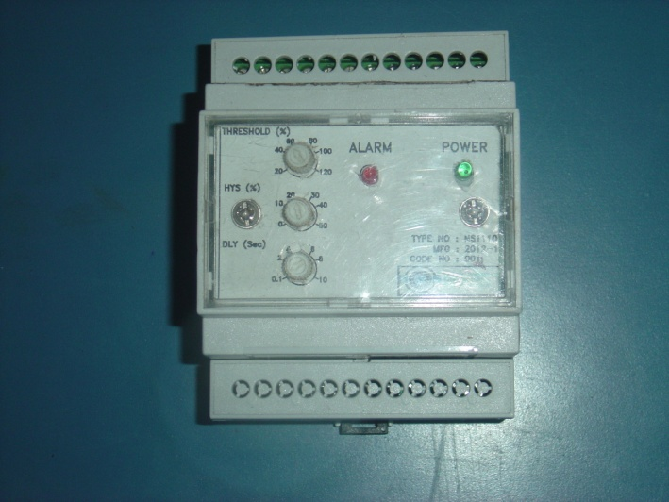
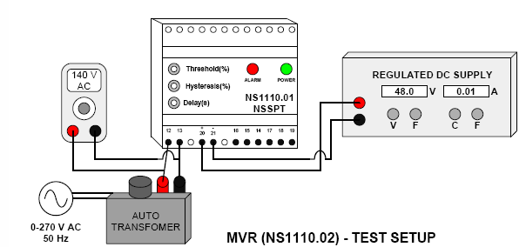
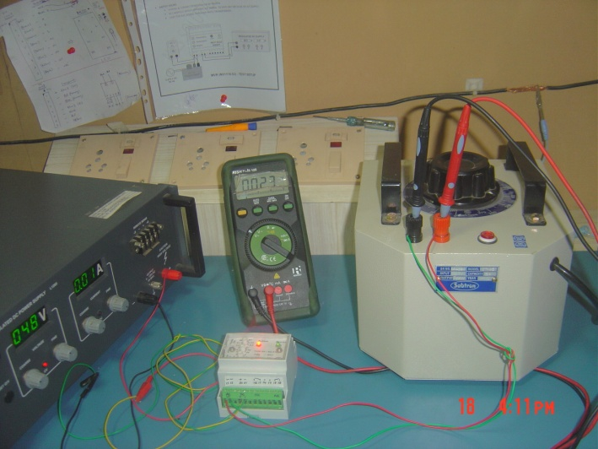
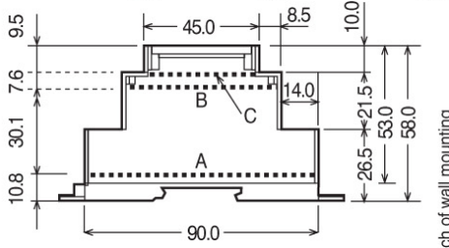
MINIMUM VOLTAGE RELAY – NS1110.01
NSSPT Developed Minimum Voltage Relay is used to protect the controller circuitry from damage due to low voltage supply. Minimum Voltage Relay is used in WAG-9, 3 – Ø, 50 Hz, 6000 Hp locomotives of Indian Railways.
The NSR family of Minimum voltage Relay is designed as low protection modules for electrical/ electronic systems. The jor advantage includes a high level of accuracy, efficiency, and reliability that remain constant over the entire operating range.
TEST SETUP
SPECIFICATION
Temperature | 15….30 Deg C
Nominal Temperature Range | 0….45 Deg C
Limit Temperature Range | -10….55 Deg C
Limit Temperature Range for storage | -25….70 Deg C
Relative Humidity | Up to 75%
Dimensions | 4 modules DIN 43880
Voltage | 10….120% UN (accuracy cl.1) 20….120% UN (accuracy cl 0, 5)
Test Voltage | 5kV standardized impulse 1, 2/50µ 0, and 5Js
OUTER DRAWING
FEATURES
Microcontroller based operation.
Adjustable Pick-Up Voltage.
Adjustable Drop-Out voltage.
Adjustable Timing.
High accuracy.
Dust protected stated Relay.
Start Up minimum DC supply detection.
Light Weight.

Slide 14
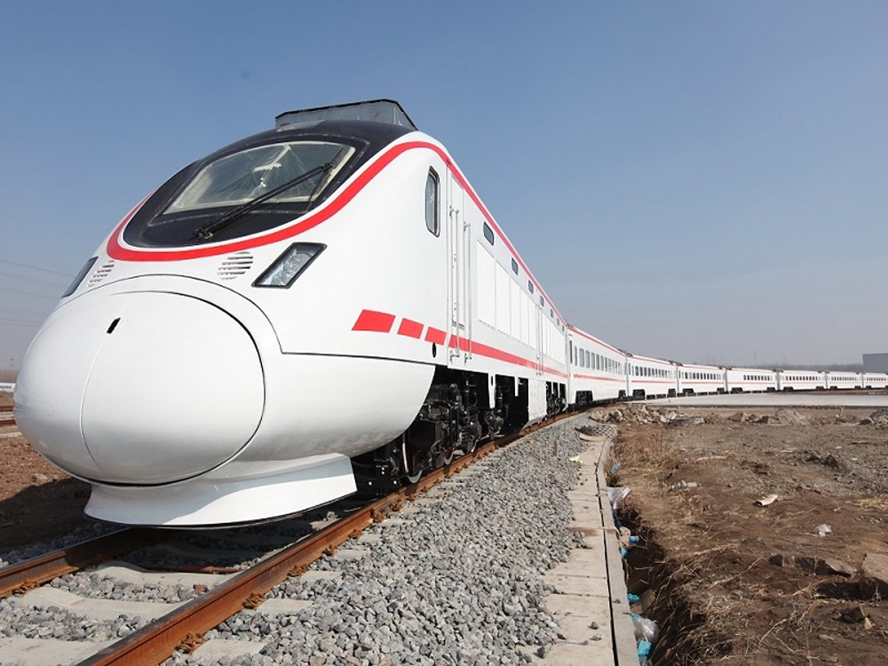
ELECTRIC LOCOMOTIVE – CONTROL SYSTEMS
1- Diagnostic Terminal – NSDT1001
2- Amplifier to Oil Circuit – NS1080
3- Driver Display Unit – NS1201
4- Fire Detection Unit – NS1060

Slide 15
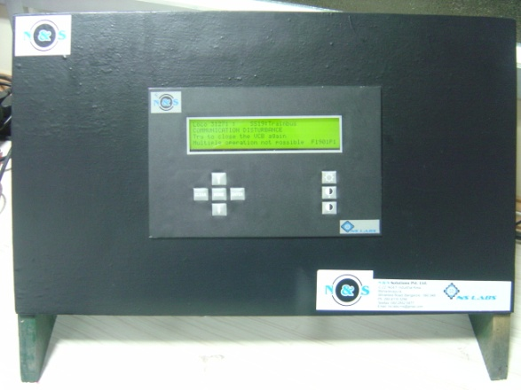
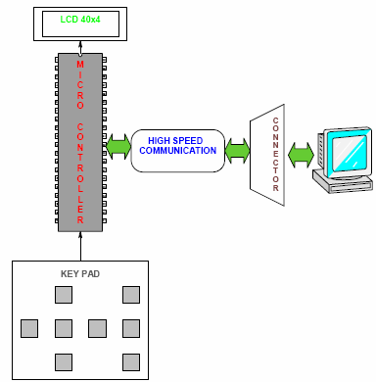
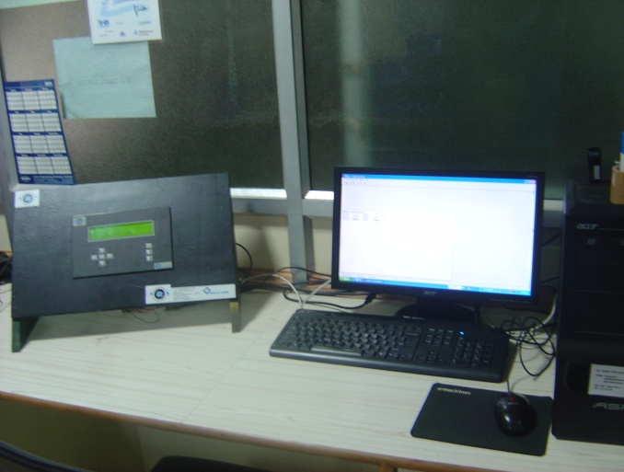
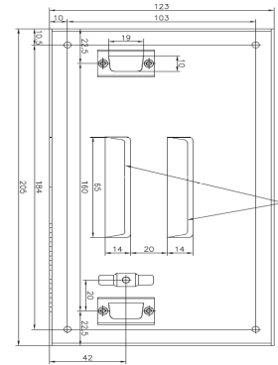
DIAGNOSTIC TERMINAL – NSDT-1001
Diagnostic Terminal module was developed for troubleshooting and online diagnosis of WAG-9 and WAP-5 (6000 HP, 3-Ø, 25 Kv, 50 Hz AC) locomotives.
The equipment is built around a High speed microcontroller and has a communication gateway enabling direct connection with locomotive control system through Isolated High Speed Serial Bus (IHSSB). This diagnostic tool acts like a network node on IHSSB and all operation status can be viewed on real-time. The equipment is very compact with input supply of 77-125 V DC.
TEST SETUP
SPECIFICATION
Display | LCD with LED Backlight (40 X 4)
Color | Yellow Green
Size | 190 mm X 54 mm X 13.5 mm
Brightness Control | Programmable Contrast Control,
Backlight | Programmable
Character set | ASCII, 8 Bit
Key Pad | 8 Keys (3 Rows X 8 Columns)
Rated Input Voltage | 77-125 V DC Power 3.0 W
OUTER DRAWING
FEATURES
The equipment is built around a High speed microcontroller.
Communication gateway enabling direct connection with locomotive control system through Isolated High Speed Serial Bus (IHSSB).
Robust Aluminum EMI/EMC protected housing.
MIC Grade PCB

Slide 16
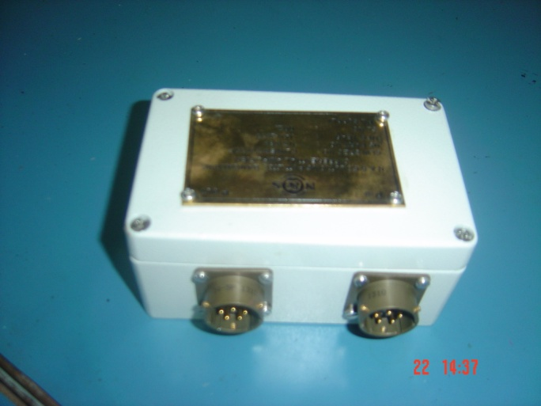
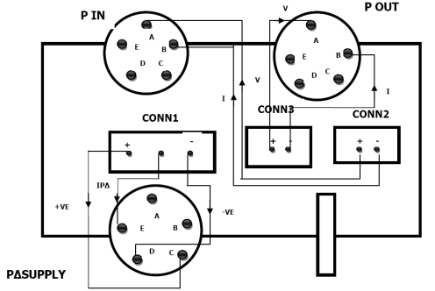
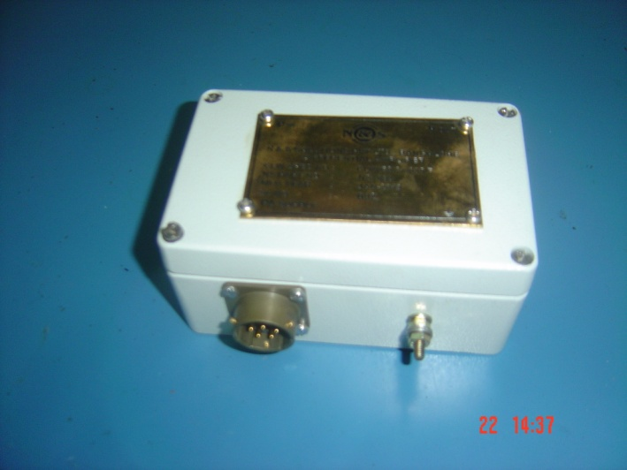
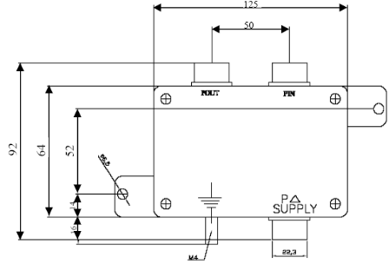
AMPLIFIER TO SENSOR OIL CIRCUIT – NS1080
The NSSPT Developed Differential Amplifier powers two two-wire loop powered 4-20mA pressure sensors and produces a single three-wire 4-20mA signal, which is proportional to the difference between the two inputs.
TEST SETUP
SPECIFICATION
Operating Voltage Area U_{B} | 18…..30 V DC
Output Signal IP | 4…..20 mA
Measuring Principle | Current Sensing
Quantity to be measured | Positive differential between two 4-20mA,
Pressure area of sensors | 0…..4 bar (relative)
Differential pressure area | 0…..2 bar (polarized)
Maximum Load resistor | 250Ω
Characteristics deviation | 0.25% of full scale
Operating Temperature | -25 to +85°C
OUTER DRAWING

Slide 17
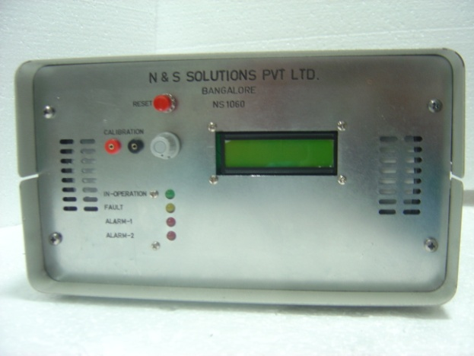
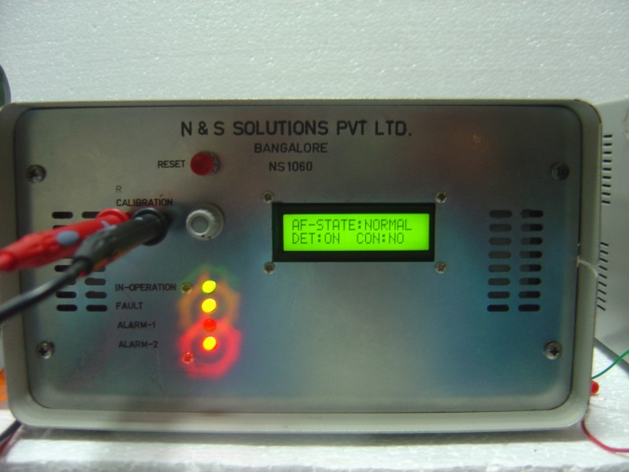
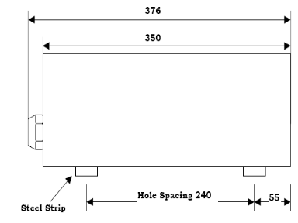
FIRE DETECTION UNIT– NS1060
NSSPT Air Sampling Fire detection unit consists of Photo Electric Smoke Detectors, Suction unit with Airflow monitoring and LED VISUAL Indications. Alphanumeric display for displaying status of the system and shows the specific types of fault so that we can easily take an action against that fault to restore the system.
All these functionalities have been supported using digital computing enabled through microcontroller which is EMI /EMC protected.
The Primary application of this unit is to detect smoldering fire occurring in vicinity of suction pipe by sensing the by product of smoldering fire (i.e. Smoke) and flaming fire.
The suction pipe is connected to the unit through a PG 29 Gland cable pipe connector. Air samples enter into the Chamber through openings on the suction pipe.
Air flow monitoring has been implemented by calculating inlet and outlet air pressure difference
SPECIFICATION
Input Supply | 20-30 V DC
Nominal Supply | 24 V DC
Dimension (H X W X L mm) | 140 X 290 X 350
Temperature Range Operation | -20° C to +60° C
Storage Temperature | -20° C to +85° C
Electrical connection | 25 way sub –D Bucket soldering Connector
OUTER DRAWING
TEST SETUP
24 V DC
FEATURES
Latest Microcontroller based circuit system
Programmable type therefore control over sensitivity , Airflow & Alarm threshold level
Power On self Diagnostics
Robust SS Construction , facility for additional smoke & Fire monitoring system
Accuracy achieved through digital computation
Fault Diagnostics Data Download , Data Download capability.
9 PIN
25 PIN

Slide 18
ELECTRIC LOCOMOTIVE – SENSORS
1- Active Speed Sensor for Traction Motor – NS1020.02
2- Pressure Sensor Oil Circuit Transformer –NS1300
3- Temperature Sensor Oil Circuit Transformer –NS1010.08

Slide 19
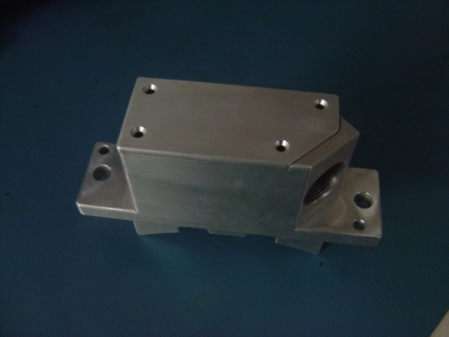

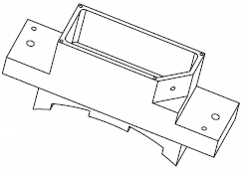
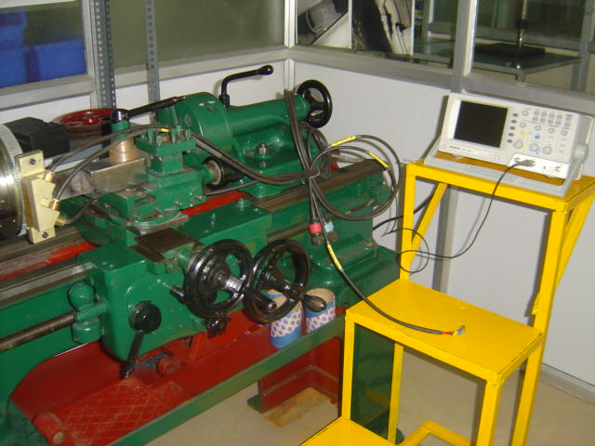
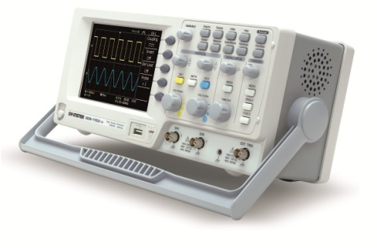

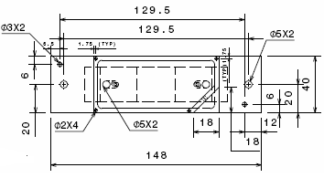
ACTIVE SPEED SENSOR FOR TRACTION MOTOR – NS1020.02
NSSPT Developed Active Speed Sensor offers industry one of the most reliable, Accurate and robust methods of speed sensing.
Purpose designing housings for arduous operating environments where Reliability is paramount.
Ease of access, convenient installation, protection against severe Environmental conditions and high tolerance to shock and vibration .
Capable of withstanding the requirements of IEC 60571, Environmental Reliability Qualification Standards.
TEST SETUP
a
B
SPECIFICATION
DC Operating voltage | 72VDC to 140VDC
Nominal Temperature Range | -40°C to +150°C
Operating Air Gap | 2.8 mm
Altitude | 2800 to 12000 Feet
Relative Humidity | 0 to 100%
Protection Classification | IP68
+
-
APPLICATIONS
The 3-phase locomotive uses the Traction Motor Speed for calculation of the Locomotive speed in order to activate the speed control and more importantly For the adhesion control during starting and braking. The effectiveness of slip Control depends upon the accuracy of the speed sensor, especially at crawling Speeds.
OUTER DRAWING

Slide 20
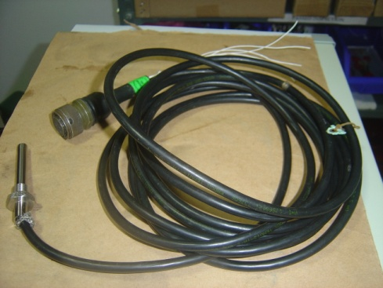
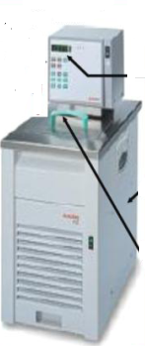

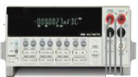
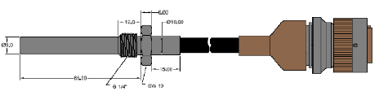
TEMPERATURE SENSOR OIL
CIRCUIT TRANSFORMER –NS1010.08
The Temperature Sensor Probe contains Dual PT100 Element within stainless steel housing for use in air, oil or water mediums for measuring Temperature. The high accuracy PT100 Element provides a fast & accurate thermal response.
TEST SETUP
SPECIFICATION
Housing Material | Stainless Steel
Sensor Construction | 2 Resistances Thermometers in one Body
Operating Temperature | -45 °C to +125 °C
Sensor Tip Environment | -45 °C to +125 °C
Test Voltage | 1000V AC for 60 Sec
Cable Type | Radox GKW RW/EMV (Electron Beam Irradiated)
Conductor | STD Tin plated copper or Equivalent
Cable Length | 3.5 meters or as required
Sensor Construction | 2 PT 100 Resistances Elements in One assembly
APPLICATION
Sensing of coolant temperature of compressor in locomotives.
Air compressor temperature detection.
Off-Highway vehicles.
Machine Condition Monitoring.
Traction Converter Cooling Circuit
Process Plant.
Sensing of Battery Box Temperature.
OUTER DRAWING

Slide 21

DIESEL LOCOMOTIVE – TEMPERATURE SENSORS
1- Sensor Assembly 1000 RTD – NS1010.01
2- Temperature Sensor Traction Motor – NS1010.12
3- Engine Temperature Sensor– NS1010.10

Slide 22
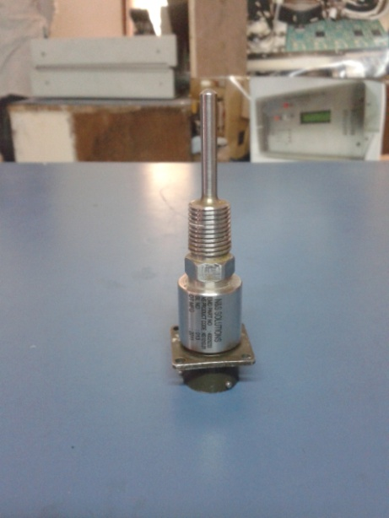

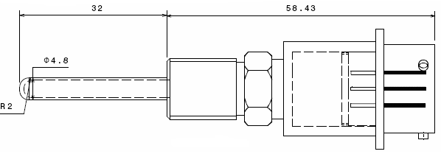
SENSOR ASSEMBLY 1000 RTD – NS1010.01
Sensor Assembly 1000 RTD contains High precision temperature sensor within stainless steel housing for use in air, oil and water medium. Three pin connector terminate these parts to the Application in Locomotive.
This unit will give change in resistance proportionate to change in temperature.
TEST SETUP
SPECIFICATION
Element | Platinum Resistance Temperature Detector 1000 Ohm ±0.06% at 0° C.
Accuracy | ± 0.5°C Over Application Range
Temperature Range | Element Rated to 500° C.
Sheath | 4.7752 OD, 316 Stainless Steel
Temperature Coefficient | 0.00385 Ohm/ Ohm/ C.Of Resistance (TCR)
Construction | Platinum Thin-Film deposited on ceramic Substrate with fused glass covering the Platinum.
Resistance | Meets DIN-IEC-751 (Formerly DIN 437600) Class A
APPLICATION
Sensing of coolant temperature of compressor in locomotives.
Air compressor temperature detection.
Sensing of Battery Box Temperature.
Machine Conditioning Monitoring.
Traction Converter Cooling Circuit
OUTER DRAWING

Slide 23
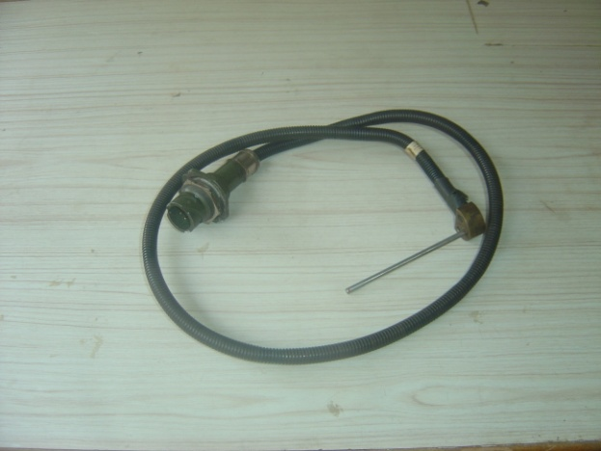
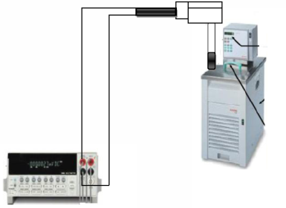
TEMPERATURE SENSOR TRACTION MOTOR – NS1010.12
Sensor Assembly 1000 RTD contains High precision temperature sensor within stainless steel housing for use in air, oil and water medium. Three pin connector terminate these parts to the Application in Locomotive.
This unit will give change in resistance proportionate to change in temperature.
TEST SETUP
SPECIFICATION
Housing Material | Stainless Steel
Sensor Construction | 1 Resistances Thermometers in one Body
Operating Temperature | -45 °C to +125 °C
Sensor Tip Environment | -45 °C to +125 °C
Test Voltage | 1000V AC for 60 Sec
Cable Type | Radox GKW RW/EMV (Electron Beam Irradiated)
Conductor | STD Tin plated copper or Equivalent
Cable Length | 3.5 meters or as required
Sensor Construction | PT 100 Resistances Elements in One assembly

Slide 24



ENGINE TEMPERATURE SENSOR– NS1010.10
The NSSPT developed Temperature Sensor offers industry one of the most reliable accurate, portable, compact and robust methods of sensing wide ranges of temperature. The sensor is capable of meeting the requirements of MIL STD 202F and IEC 571.
SPECIFICATION
MATERIAL | Stainless steel SS304/316I/18-10
SENSOR | -40°C to + 150°C
SENSOR RESISTANCE | 40000 +/-0.88% Ohms @ 25°C
AMBIENT TEMPERATURE | -55°C to +150°C
RELATIVE HUMIDITY | 0-100%
MOUNTING THREAD | ¼ Inch NPTF Male
CONNECTORS | 2-Pin Amphenol 97-3101A-10SL-4P(426) OR equivalent
APPLICATION
OUTER DRAWING
Sensing of coolant temperature of compressor in locomotives.
Sensing of Battery Box temperature.
Air compressor temperature detection.
Machine Conditioning Monitoring.
Traction Converter Cooling Circuit.

Slide 25

DIESEL LOCOMOTIVE – SPEED SENSORS/ RADAR ASSY
1- Sensor Turbo Speed – NS1020.06
2- Pick Up Magnetic Speed Sensor – NS1020.05
3- Magnetic Speed Sensor– NS1020.04
4- Radar Assembly – NS1020.07

Slide 26





SENSOR TURBO SPEED – NS1020.06
NSSPT developed Turbo Speed Sensor is used in Diesel Electric Locomotive for control Circuitry.
The device with both the terminals tied together will withstand the voltage of 500 V AC, rms 60 Hz to case for one minute. The maximum rate of application of voltage is 100 V AC rms/ sec.
The materials used are inherently non- nutrient to fungus and shall not blister, crack, outgas, blow or exhibit other immediate or latent defects that adversely affect storage, operation or environmental capabilities of these devices.
TEST SETUP
B
a
SPECIFICATION
PARAMETER | VALUE
Output Voltage | 5.0 V PK-PK MIN
Coil Resistance | 360 Ohms Max
Inductance | 50MH Max
Dielectric Strength | 500V RMS at 60Hz for 1 Min. Max not to exceed 100V per second
Leakage Resistance | 100 Mega Ohms Min
Temperature Limit | -67° F TO +350°F
-
+
OUTER DRAWING
FEATURES
Specially designed for the complete versatility of speed sensing
Small, Robust easy to install.
Designed for use in harsh working environment and hazardous areas.

Slide 27



PICKUP MAGNETIC SPEED SENSOR– NS1020.05
NSSPT Developed Pick up Magnetic Speed Sensor is a passive single channel sensor with variable frequency AC voltage output. It offers industrial one of the most reliable, accurate and robust methods of speed sensing.
In the Sensor the magnetic core is exposed through the end of the sensor body for reducing the air gap between the sensor and the target & thereby yielding greater low speed sensitivity.
TEST SETUP
B
a
SPECIFICATION
PARAMETER | VALUE
Resistance | 200 Ohms Max @20°C
Inductance | 65 TO 85 MH
Capacitance | 14MMF(Average)
Insulation Resistance to shell | 100 megohms
Temperature Range | -100° F TO +225°F
-
+
OUTER DRAWING
APPLICATION
CAM & CRANK shaft position/ Speed measurement.
Detection of direction & position of Gear wheel.
Turbo shaft speed measurement

Slide 28




MAGNETIC SPEED SENSOR– NS1020.04
NSSPT Developed Magnetic Pick Up Speed Sensor offers industry one of the most reliable, accurate and robust methods of speed sensing.
Purpose designing housings for arduous operating environments where reliability is paramount.
Ease of access, convenient installation, protection against severe environmental conditions and high tolerance to shock and vibration.
Capable of withstanding the requirements of MIL 202F, Environmental Reliability Qualification Standards.
TEST SETUP
a
B
+
-
SPECIFICATION
Ambient Temperature Limit | -40°C to +85°C
Operating Air Gap | For min. voltage requirement: 0.033” For max. Voltage requirement: 0.017”
Altitude | 2800 to 12000 Feet
Relative Humidity | 0 to 100%
Frequency Range | 10Hz to 2700Hz derived from a 10 Pitch, 60 Tooth, 20 deg. Pressure angle gear with the air Gap
OUTER DRAWING
APPLICATION
A.C. Traction Motor Speed Sensing in Locomotives

Slide 29


RADAR ASSEMBLY – NS1020.07
A change in the observed frequency of a wave, occurring when the source and observer are in motion relative to each other, with the frequency increasing when the source and observer approach each other and decreasing when they move apart. The motion of the source causes a real shift in frequency of the wave, while the motion of the observer produces only an apparent shift in frequency. Also called Doppler shift. Speed sensing Radar uses the principle of Doppler shift to determine the ground speed of the vehicle or other type of equipment. A microwave signal that is transmitted out of the sensor reflects off the target and is received by the sensor. When the target (terrain) is moving relative to the sensor, there is a change in the frequency of the reflected signal (Doppler shift). The ground speed is calculated by measuring the change in frequency.
TEST SETUP
RADAR ASSM
APPLICATION
Actual ground speed monitoring
Direction detection.
SPECIFICATION
Input Supply | 72 V Dc Nominal (48 – 88 V Dc)
Output frequency | 22.5 Hz / Mph
Mounting Angle | 37.5⁰
Radar type | K-Band Radar
Antenna type | Planner array antenna
Transmission Frequency | 24.125 GHz
Band width | 500 MHz
Velocity range | 0.5 – 180 Km/h
15 V
5 V

Slide 30

DIESEL LOCOMOTIVE – ELECTRONIC/ELECTRICAL PRODUCTS
1- Electronic Water Level Indicator – NS 1030.01
2- LT Indication Panel – NS1130
3- Main Reservoir Pressure Transducer – NS1300

Slide 31





ELECTRONIC WATER LEVEL INDICATOR– NS1030.01
Electronic water level indicator is used in EMD Locomotive to check the water level. This unit issues has three probes of different sizes to detect the level of water.
This unit works on the principle of current conduction property of water. When water level reduces to 25 %, it isolates the whole loco control system from supply to protect other control circuitry from excessive heating effect.
There are three different level detection and indication system is involved (i.e. 100%, 50%, 25 %). For each level indication there is one LED provided on front panel of controller.
This unit contains two different systems (i.e. Sensor unit & Controller unit). The sensor unit is to be fitted in the pressurized water expansion tank of diesel locomotive to sense the water level inside the tank. The control panel has been fitted inside the driver’s cab to give audio-visual indication to the driver having relay with “NO” and “NC” contacts
TEST SETUP
OUTER DRAWING
SPECIFICATION
Current Consumption | 32 m Amp (Max
Display System | 3 LED (for 3 states)
Operating Voltage | 72 V Dc (Nominal), 48 V Dc to 88 V Dc
Ambient Temperature | 0°C to 70°C
Relative humidity | 100%
Ambient Condition | 1.6 mg/cub m Dust Level
APPLICATION
High Operating Voltage: 48 V Dc to 88 V Dc
High Accuracy
Stainless steel body
Fast response
High reliability
Sound Construction

Slide 32



LT INDICATION PANEL – NS1130
This unit is an indication unit. It takes input from various sensor available in the locomotive and generate output in the form of flashing LED at the front panel and then in respective terminal.
Panel consists of 6 switches as mentioned below:
TE LIMIT
SAND LIGHT
WHEEL SLIP
FLASHER LAMP
PCS (Pneumatic Control System)
BREAK WARN
TE LIMIT: It indicates Tractive Effort limiting functions have been activated from Microprocessor.
SAND LIGHT: It indicates that sanding request has been made to the Microprocessor by means of sand switch actuation on the locomotives. Other sanding request are made by the emergency air break apply.
WHEEL SLIP: The condition cause the wheel slip light to switch ON is locked wheel and these conditions is not simulating in the panel.
FLASHER LAMP: Flasher ON/OFF when either outside flasher lamp is flashing provided that flasher lamp is not burned out and light circuit breaker is closed flashes at same rate at the outside flasher lamp.
PCS (Pneumatic Control System): When the pressure is below 3.8 kg/cm² in main reservoir the PCS get on when EM it is recommend its goes OFF
BREAK WARNS: The light turns ON whenever the locomotive is generating excessive dynamic breaking current regardless of Tractive Effort meter reading.
TEST SETUP
72 VDC

Slide 33


MAIN RESERVIOR PRESSURE TRANSDCER – NS1300
TEST SETUP
The sensing Element is ceramic capsule connected to signal conditioning circuit to provide a 2 wire, 4…20MA and linear pressure related output signal
FEATURES
Pressure ranges from 0 to 20 bar
Chemical and corrosion resistant ceramic diaphragm with integral temperature compensation
2 Wire, loop powered 4….20ma linear analogue outputs.
Designed for use in harsh working environments and hazardous areas
Gauge or absolute.
High impact and vibration tolerance for heavy – duty applications.
Stainless steel housing with various connection options.
Standard pressure connection ¼” NPT Internal (other pressure ports available to special order)
72 VDC

Slide 34

LOCOMOTIVE CONTROL PANELS
1- HB 1 & HB 2 AND SB1 & SB2 PANELS
2- Driver Control Desk for Locomotives

Slide 35







Facilities Resources

Slide 36







Facilities Resources

Slide 37



PRODUCT LIFE CYCLE MANAGEMENT-
ENVIRONMENT QUALIFICATION TEST –NABL CERTIFIED
VIBRATION TEST- VERTICAL
VIBRATION TEST- HORZONTAL
VIBRATION TEST- SENSORS

Slide 38




PRODUCTS COMMISSIONED ON LOCOMOTIVES
FOR FIELD TRIAL & APPROVALS

Slide 39

Esteemed Clients of N & S Solutions
Chittaranjan Locomotive Works (CLW)
Diesel Locomotive Works (DLW)
Central Railway
East Central Railway
Northern Railway
North Eastern Railway
Northeast Frontier Railway
North Western Railway
Southern Railway
South Central Railway
South Eastern Railway
South East Central Railway
South Western Railway
West Central Railway
Western Railway
Rail Wheel Factory
GE Transportation India Ltd
ICF – Integral Coach factory
RCF – Rail Coach Factory

Slide 40


Certification
GST NO: 29AABCN9709K1ZX TAN NO: BLRNO4400E PAN NO.: AABCN9709K

Slide 41






NS DEMO SIMULATION COACH FOR LIVE SMOKE AND PERFORMANCE TESTING

Slide 42



N & S SOLUTIONS PVT LTD.,
ISO 9001:2008 COMPANY
REGISTERED ADDRESS:
N&S SOLUTIONS PVT LTD
NO:37-38 RELIABLE RESIDENCY, 1st MAIN
8th CROSS, HARLUR, HSR LAYOUT
BANGALORE – 560104
FACTORY ADDRESS: N&S SOLUTIONS PVT LTD
BUILDING NO: 31,32,33,34,35
SHREE ANGALA PARAMESHWARI RESIDENCY
MUNESHWARA LAYOUT, HARALUKUNTE
KUDLU MAIN ROAD, BANGALORE-560068
MARKETING & R&D OFFICE: N&S
BUILDING NO.4, 4th FLOOR,
12th CROSS, MUNESHWARA LAYOUT
HARALUKUNTE, KUDLU MAIN ROAD
BANGALORE-560068
PLEASE CONTACT FOR SALES: sales@nssolutions.in
FOR SERVICES: nsservicetrain18@gmail.com

